Slide 1
CSE 2451 Statements and Flow Control
Zichen Zhang

Slide 2
Overview
Statements
Selection statement
If statement
switch-case statement
Iteration statement
while statement
do while statement
for statement
Jump statement
break
continue
return
goto

Slide 3
statement
Statements are fragments of the C program that are executed in sequence
5 types of statement
expression statements
compound statements
selection statements
If, swtich
Iteration statements
while, do while, for
Jump statements
break, continue, return, goto
Notes:
Source: https://en.cppreference.com/w/c/language/statements

Slide 4

Expression statement
expression (optional); // semicolon ; is part of the statement
An expression followed by a semicolon is an expression statement
Most statements in C are expression statements, e.g.,
Assignments (declaration is not statement)
Function calls
Empty expression with just semicolon is still a statement: null statement

Slide 5
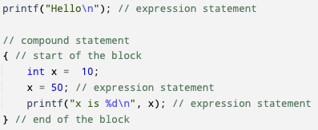
Compound Statement
{statement | declaration (optional); |… }
A compound statement, or block, is a brace-enclosed sequence of statements and declarations

Slide 6
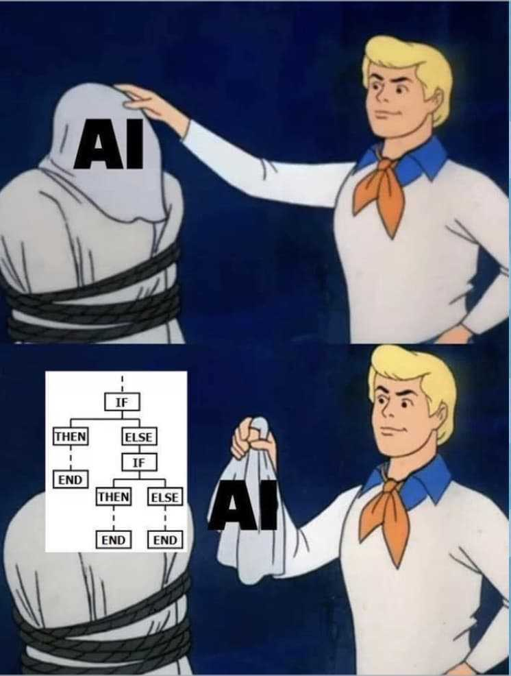
Selection statement
The selection statements choose between one of several statements depending on the value of an expression
If statement
switch statement

Slide 7
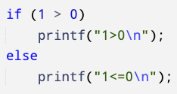
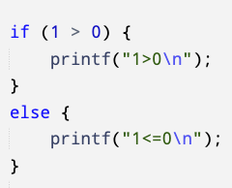
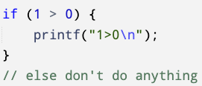
if statement
if statement has two basic form
if (expression) statement_1 // version 1
if (expression) statement_1 else statement_2 // version 2
if the expression evaluates to non-zero values (true), the statement_1 will be executed, otherwise
Do nothing // version 1
Execute statement_2 // version 2

Slide 8
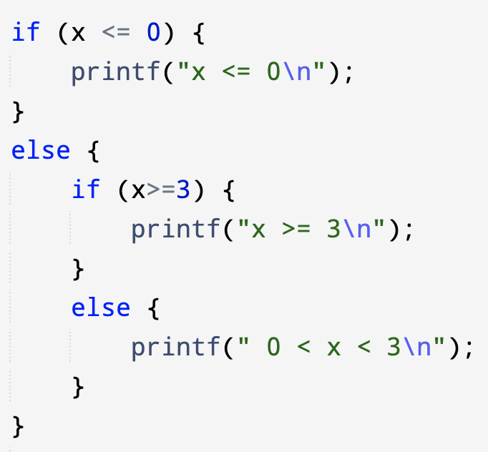
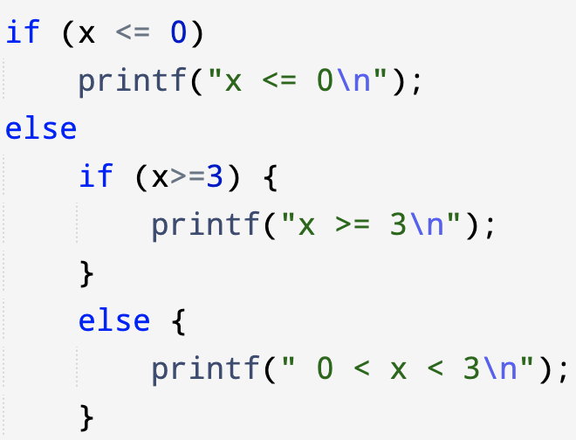
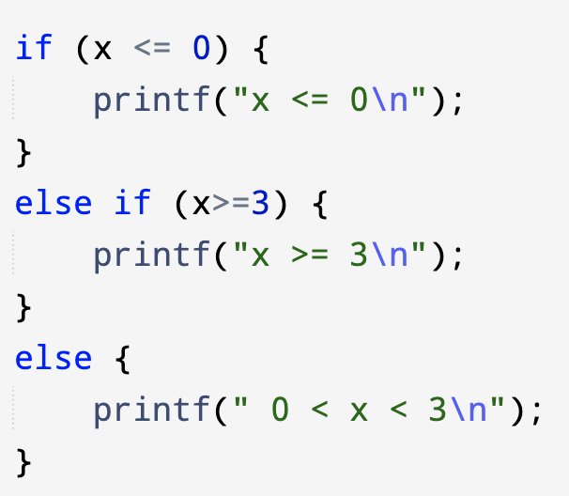
if statement
if statement has two basic form
if (expression) statement_1
if (expression) statement_1 else statement_2
Statement_1 or statement_2 can be compound statement, or other type of statements (i.e., a sequence of statements encapsuled by {} or another selection statement )

Slide 9
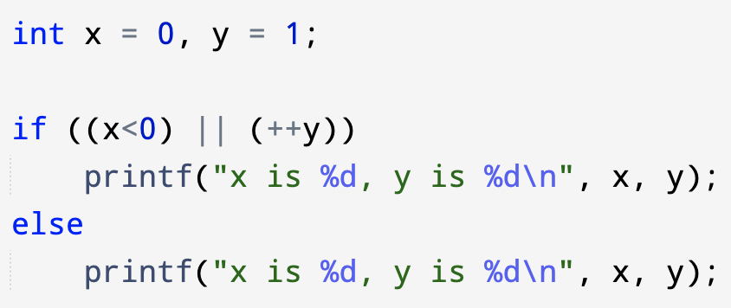
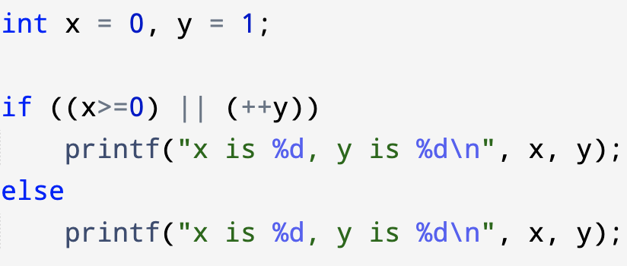
if statement + short-circuit evaluation
What’s the values of x and y printed on the screen?
Notes:
Left: x is 0, y is 2
Right: x is 0, y is 1

Slide 10
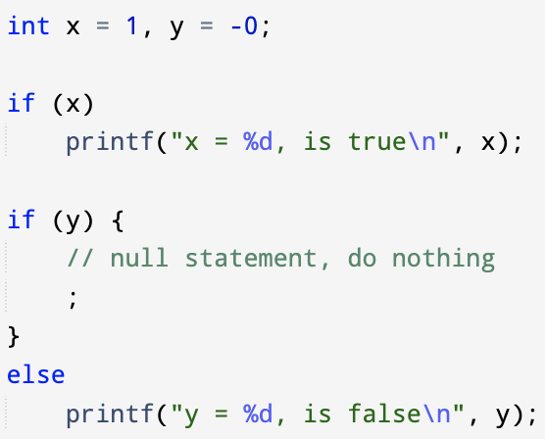
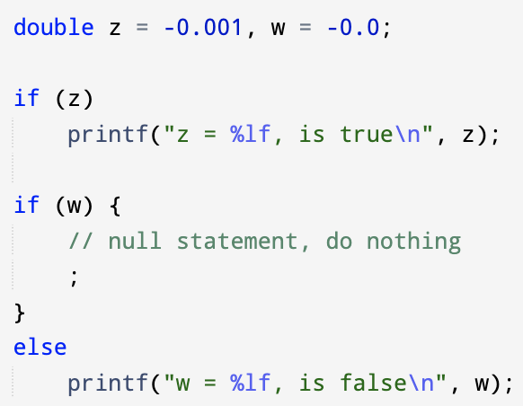


If statement - example
Non-zero scalar values (integral type, floating-point type, pointer type) evaluate to TRUE as conditional expression

Slide 11
switch-case statement
Switch statement has the following format
The value of expression dictates which statement the program starts to execute
switch(expression) {
case constant_expression_1: statement_1
case constant_expression_2: statement_2
…
case constant_expression_N: statement_N
default: default_statement
}
Constant expression is evaluated at compile time, not runtime.
Constant expression used in switch statement must be able to be reduced to integral type
e.g., integer constant, character constant

Slide 12
switch-case statement
If expression evaluates to a value matching the constant_expression_2, the program starts to execute from statement_2, proceeds to execute the following statements all the way down to the default_statement
A match between expression and constant expression specifies the entry point
switch statement has the following format
The value of expression dictates which statement the program starts to execute
switch(expression) {
case constant_expression_1: statement_1
case constant_expression_2: statement_2
…
case constant_expression_N: statement_N
default: default_statement
}

Slide 13
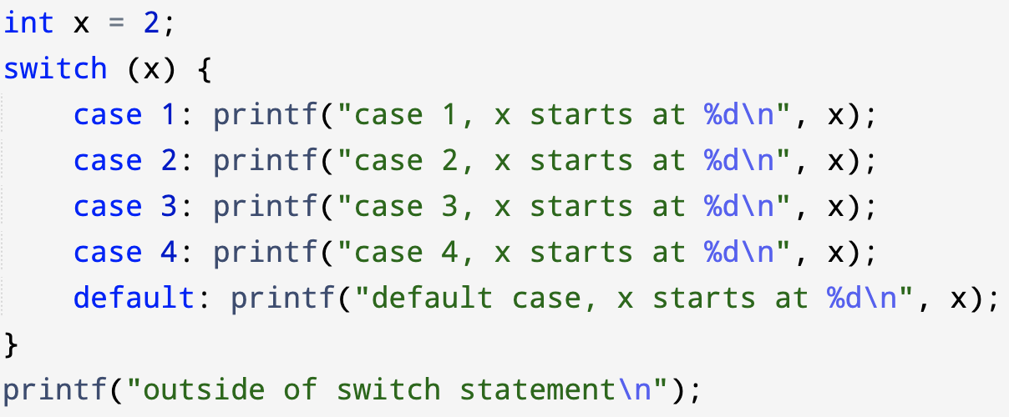
switch-case statement - example
What’s the results shown in the terminal?
Notes:
All print statement starting from case 2 to default case

Slide 14
Iteration statements
The iteration statements repeatedly execute a (compound) statement
while statement
do while statement
for statement
one iteration (statements)
condition
If condition is true
If condition is false

Slide 15
while statement
while statement has the following format
(1) First check the expression value
(2) If false, terminates while loop
(3) If true, enters the iteration, and executes statements inside the while loop, go back to step (1)
while (expression) statement
one iteration (statements)
condition
If condition is true
If condition is false

Slide 16
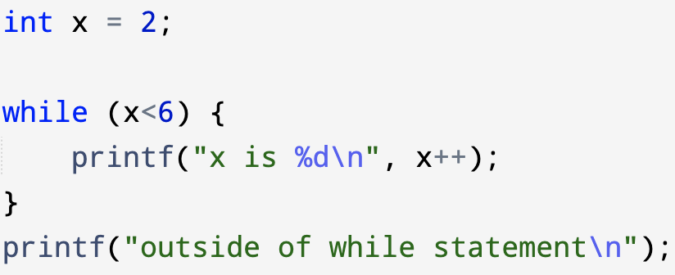
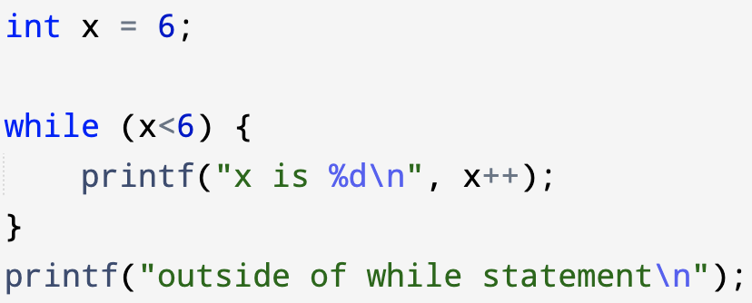
while statement - example
What’s the result shown in the terminal?
Notes:
Left: x is 2, x is 3, x is 4, x is 5, followed by outside of while statement
Right: outside of while statement

Slide 17
do-while statement
do-while statement has the following format
(1) First enters the iteration, and executes statement inside the do-while loop
(2) Then checks the expression value
(3) If false, terminates the loop
(4) If true, go back to step (1)
do statement while (expression);
one iteration (statements)
If condition is true
condition
If condition is false

Slide 18
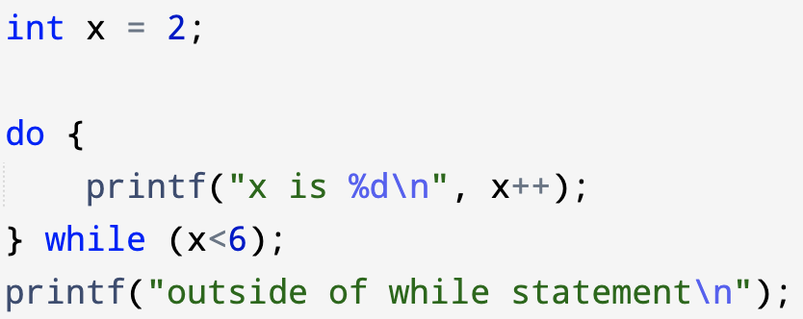
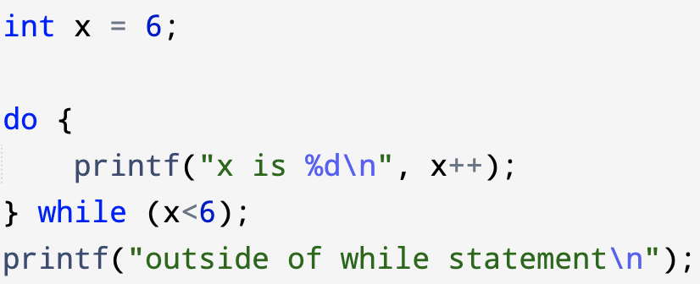
do-while statement - example
What’s the result shown in the terminal?
Notes:
Left: x is 2 followed by outside of while statement
Right: x is 6 followed by outside of while statement

Slide 19

while vs do-while
while: first check conditional expression
do-while: first execute, then check conditional expression

Slide 20
for statement
for statement has the following format
(1) First initialize iteration variable (init- clause)
may be a declaration (since C99)
may be an expression (usually an assignment expression)
Evaluated once at initial entry of for-loop
optional
(2) evaluate cond-expression, check its value
Evaluates before entry of every iteration
Optional, if omitted, will be set to be a non-zero constant, resulting endless loop
(3) if true, executes statements inside the loop, then updates the associated iteration variable (iteration-expression), go back to step (2)
Iteration-expression gets evaluated after every iteration
(4) if false, terminates the loop
Initialize iteration variable (optional)
Update iteration variable (optional)
one iteration (statements / code)
condition
If condition is true
for (init-clause (optional) ; cond-expression (optional); iteration-expression (optional)) statement
If condition is false

Slide 21
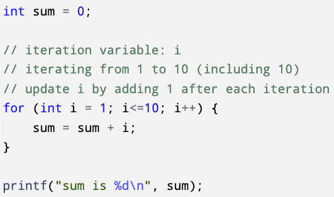
for statement - example
Sum integers from 1 to 10, including 10
Initialize iteration variable (int i=1)
Update iteration variable (i++)
one iteration
(sum = sum + i)
Condition (i<=10)
If condition is true
If condition is false

Slide 22
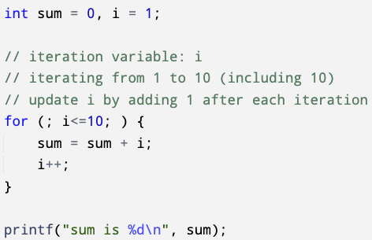
for statement - example
Sum integers from 1 to 10, including 10
Initialize iteration variable (empty)
Update iteration variable (empty)
one iteration
(sum = sum + i; i++;)
Condition (i<=10)
If condition is true
If condition is false

Slide 23
for statement - example
Sum integers from 1 to 10, including 10
Initialize iteration variable (empty)
Update iteration variable (empty)
one iteration
(sum = sum + i; i++;)
This is effectively a while-loop
Condition (i<=10)
If condition is true
If condition is false

Slide 24
Jump statements
The jump statements unconditionally transfer flow control
break statement
continue statement
goto statement
return statement with an optional expression

Slide 25
Break and continue statements
break statement
Causes the enclosing for, while or do-while loop, or switch statement to terminate
After this statement the control is transferred to the statement or declaration immediately following the enclosing loop or switch statement
A break statement cannot be used to break out of multiple nested loops. The goto statement may be used for this purpose
continue statement
Causes the remaining portion of the enclosing for, while, or do-while loop body to be skipped

Slide 26
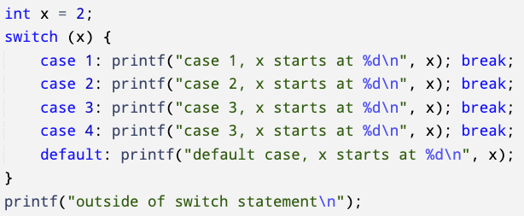
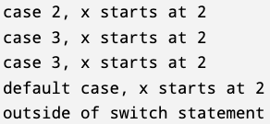

switch + break
switch with break statement for each case: only statements in the matching case get executed

Slide 27
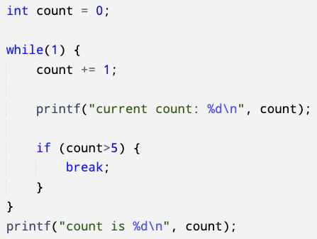
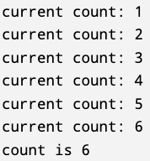
Loop + break
Immediate exists of the loop, and start to execute code outside the while/do-while/for statements

Slide 28
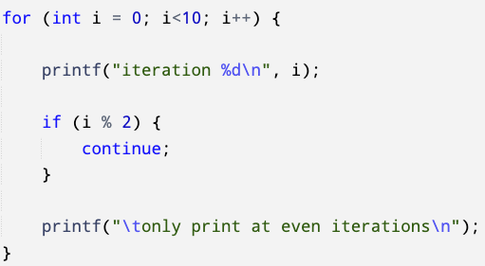
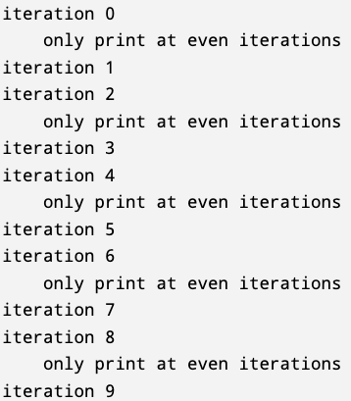
Loop + continue
Skip the rest of code after the continue statement in the loop

Slide 29
goto statement
goto statement is used together with labels
goto label; // immediately transfer the control to the location specified by // label in your source file
goto statement can be used to jump out of nested loops
Too many goto statement leads to code very difficult to maintain (“goto statement considered harmful” by Edsger Dijkstra)
A label is an identifier followed by a colon : symbol
E.g., XYZ:, is a label named XYZ
A label’s name also needs to avoid name collision with C keywords
A label can be placed anywhere in the C program as long as it’s in the same function with the pairing goto statement

Slide 30
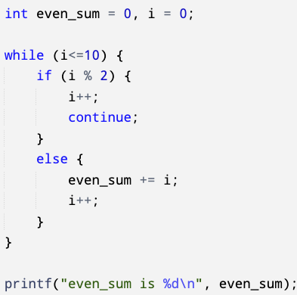
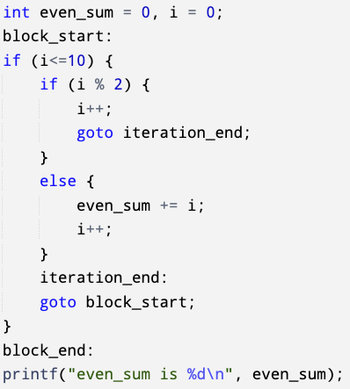
goto statement - example
sum of all even numbers between 0 and 10 (including 10)

Slide 31
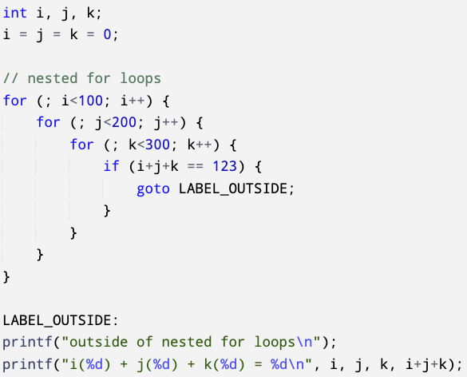
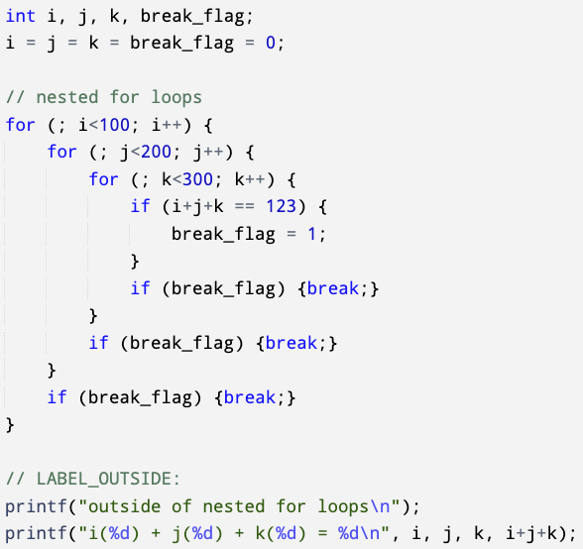

goto statement - example
Use goto statement to jump out of nested loops

Slide 32
Return statement
Terminates current function and returns specified value to the caller function
Return ; // the function has no return value
Return expression ; // the function has a return value
Notes:
https://en.cppreference.com/w/c/language/return
https://en.cppreference.com/w/c/language/main_function

